Slide 1
Small Bites Online Food Order

Slide 2
Team
Dholariya Jaimish (20SOECE11015)
Dhameliya Chintan (20SOECE11013)
Gediya Prins (20SOECE11018)
Kumbhani Daksh (20SOECE11040)

Slide 3
Work Done BY Team Members
1. UI Designing
2. Wire Frame
3. PPT Designing
4. srs document
1. Frontend
2. database connection
3. backend
1. srs document
2. frontend
3. diagram
4. documentation
1. software testing
2. diagram
Dholariya Jaimish
Dhameliya Chintan
Gediya Prins
Kumbhani Daksh

Slide 4
Need of application
An app is fast, easy and comfortable to use. There are no misunderstandings or frustrations as can happen with ordering over the phone. In a nutshell, Our customers choose to order food through the app because it’s at their fingertips.
Online ordering through a food delivery app can help us reach new customers outside our regulars and locals. By enhancing our brand’s online presence in the market, we can boost our sales with new and returning customers.
An app allows customers to order anytime, anywhere using their mobiles, tablets or other devices. With a food delivery app, the customer can quietly place an order without the hassle of talking over the phone.
Sometimes customers want our food but in the comfort of their own home. Whether that’s due to ongoing restrictions, bad weather or simply the desire to stay home, by offering delivery you’re able to serve a wider range of customers.
Our restaurant seating capacity may be 100 at a time, or perhaps less, but with a food delivery service app you can reach thousands of people. All we need is an integrated ordering system, and you are good to go!

Slide 5
Scope of application
As you know now-a-days everything is becoming online.
So our application will be used by users to order food online from their home.
Food will be delivered on customer’s door step.

Slide 6

Features of application
Easy Search
Security
Easy add to cart with one click item
Classified Products
Easy payment methods
Responsive Application
User-friendly Interface

Slide 7



Technology
Software specification
User specification
RAM and rom specification
Project type : Mobile Application
Database Application: Google Firebase
Operating System for testing: Android
Language: Java
Login
Register
Edit Profile
View the Food list
Select Food and Order Food
Logout
RAM :- Min. 3 GB
Android Version:- Android 5.0 or above.

Slide 8

Limitation of application
Quality of food may suffer.
Food delivery services are often late.
Online payment not available
Order tracking not available

Slide 9
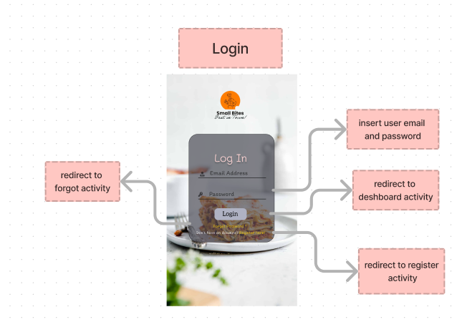
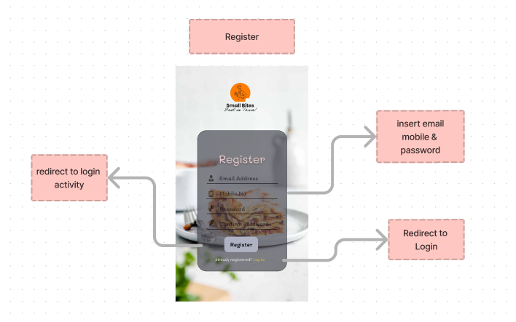
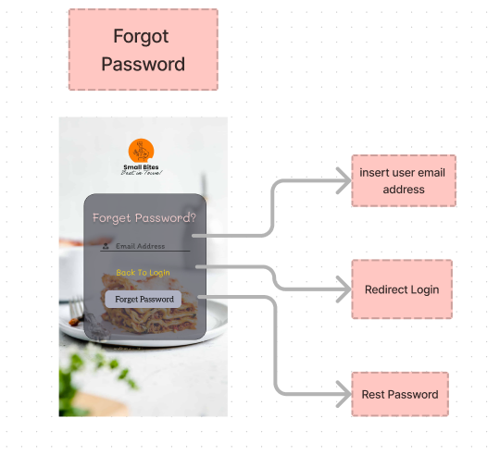
Wireframe and prototype

Slide 10
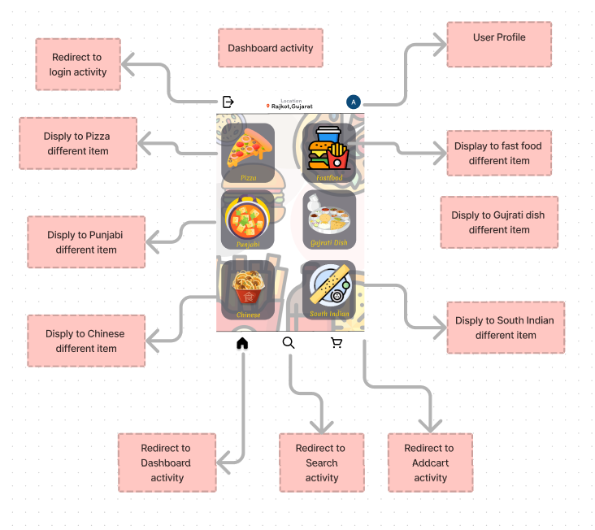
Wireframe and prototype

Slide 11
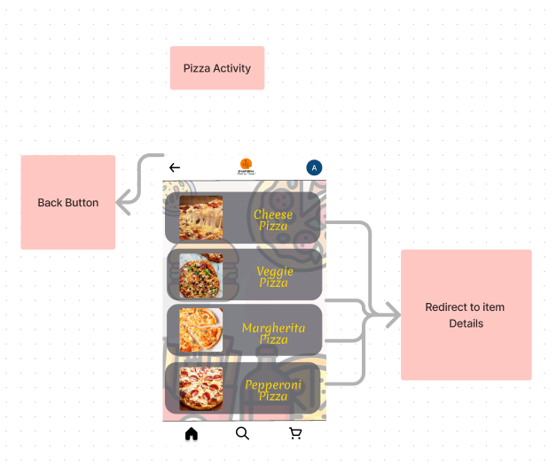
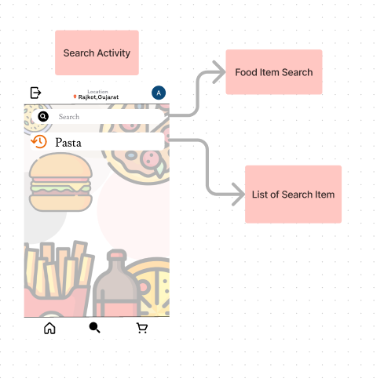
Wireframe and prototype

Slide 12
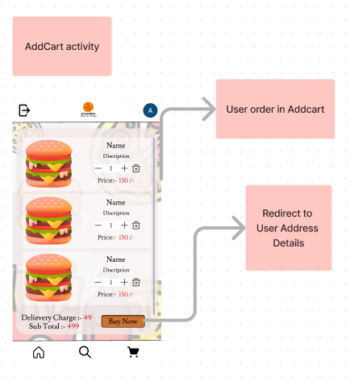
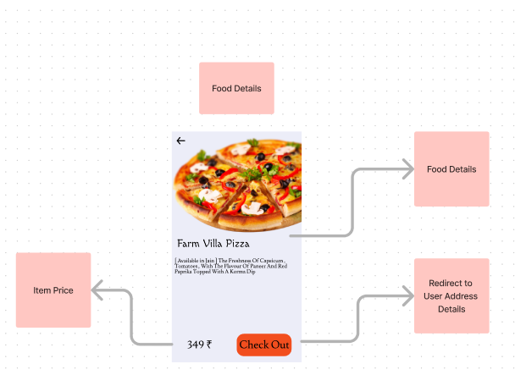
Wireframe and prototype

Slide 13
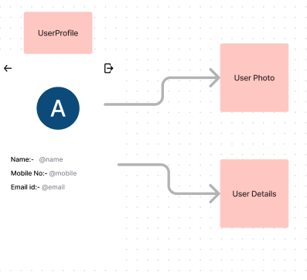
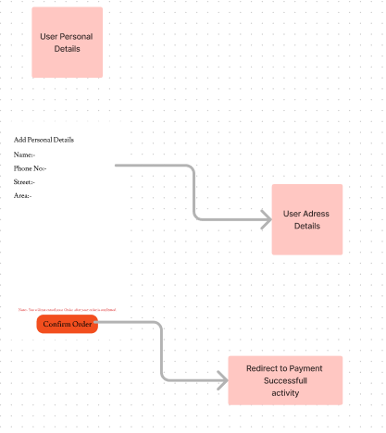
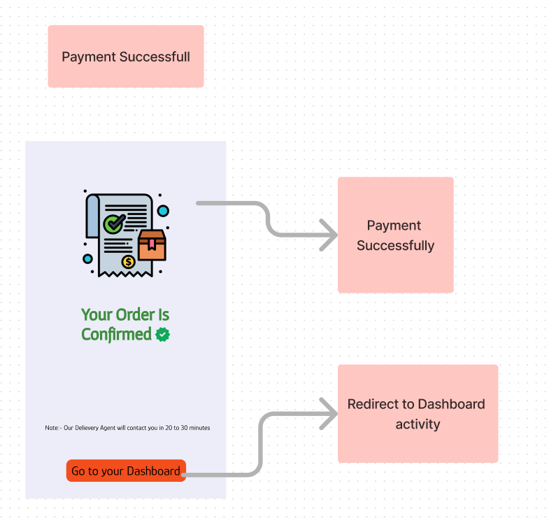
Wireframe and prototype

Slide 14
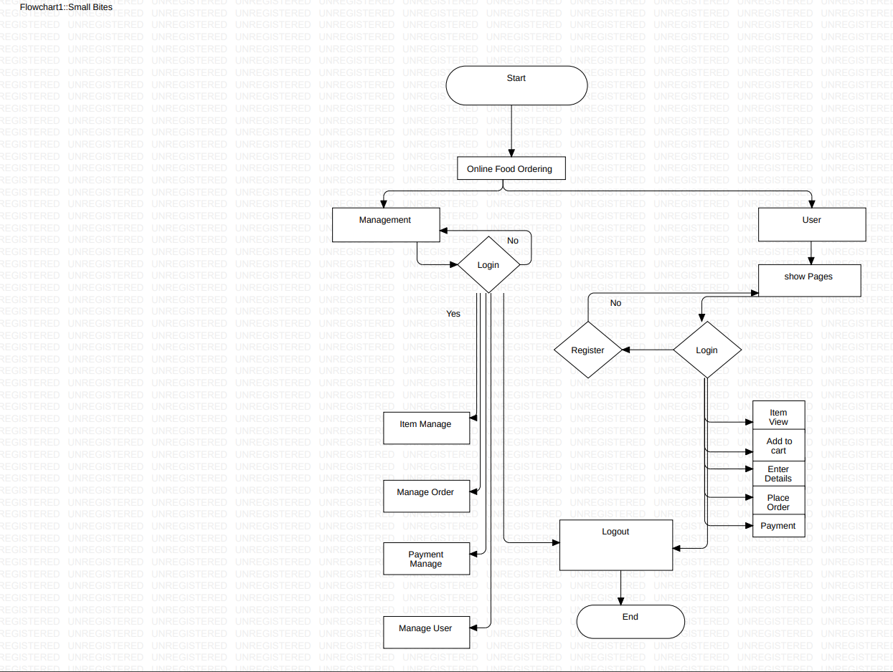
Diagrams
1. Flow Chart

Slide 15
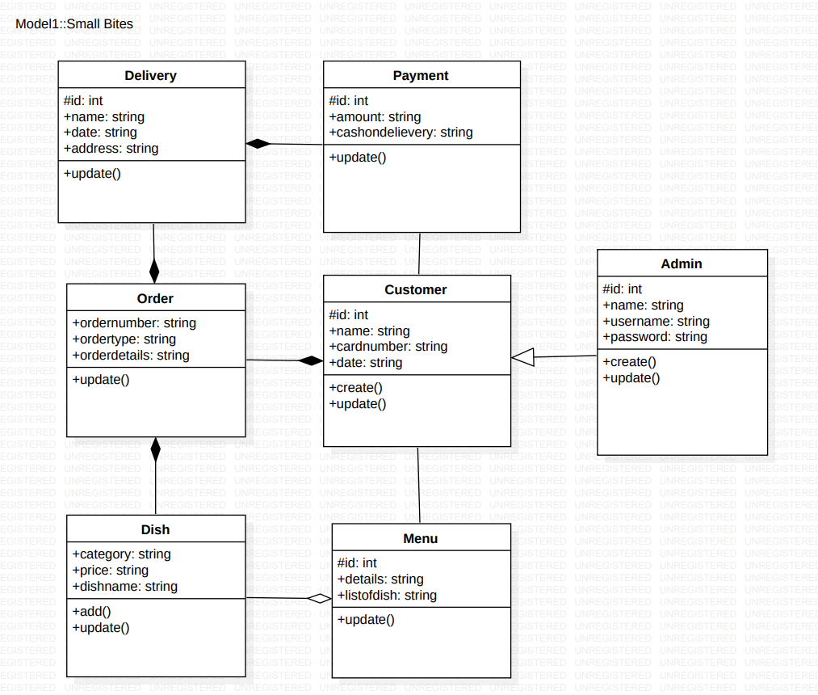
Diagrams
2. Class Diagram

Slide 16
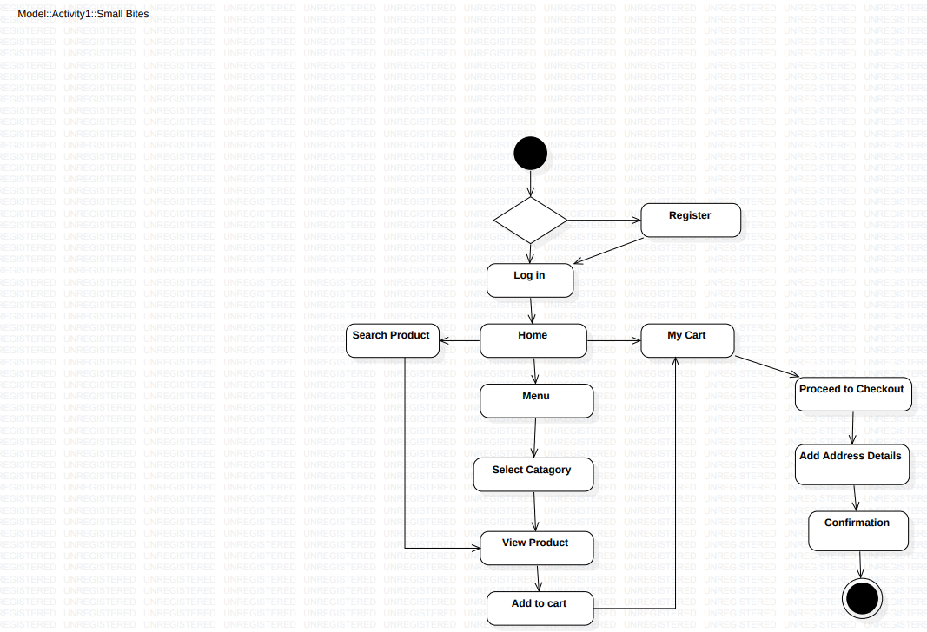
Diagrams
3. Activity Diagram

Slide 17
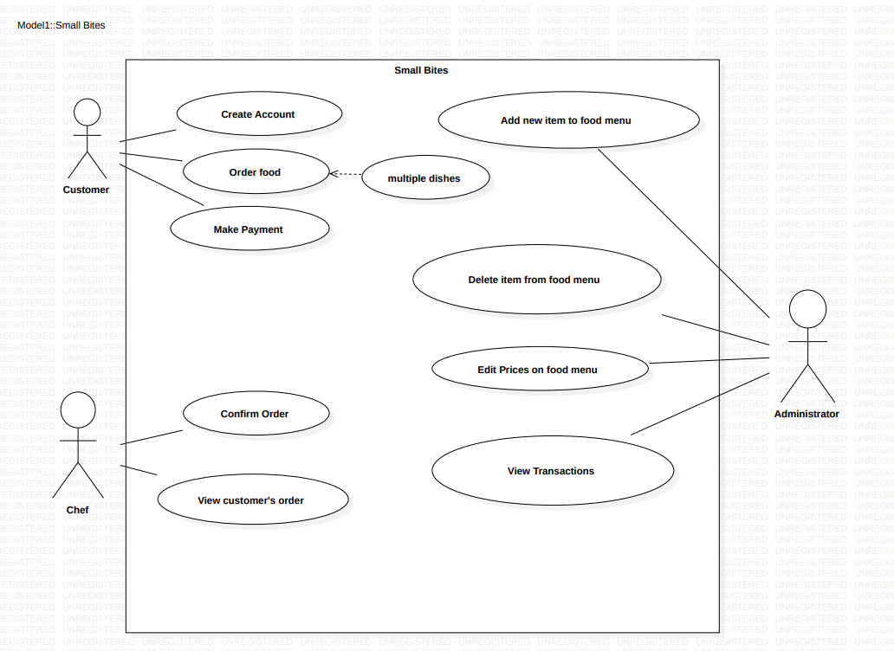
Diagrams
4. Use Case Diagram

Slide 18
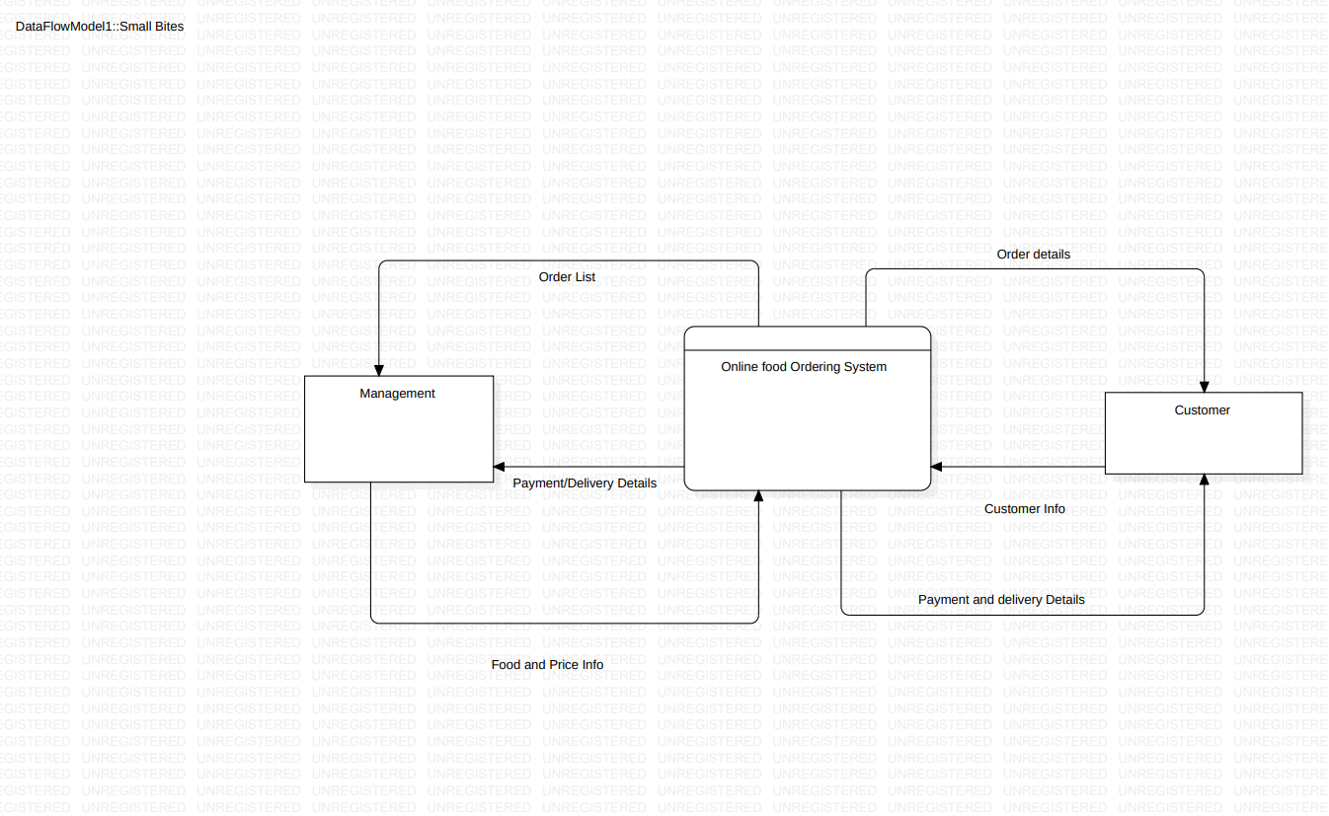
Diagrams
5. Data Flow Diagram
5.1 Level 0

Slide 19
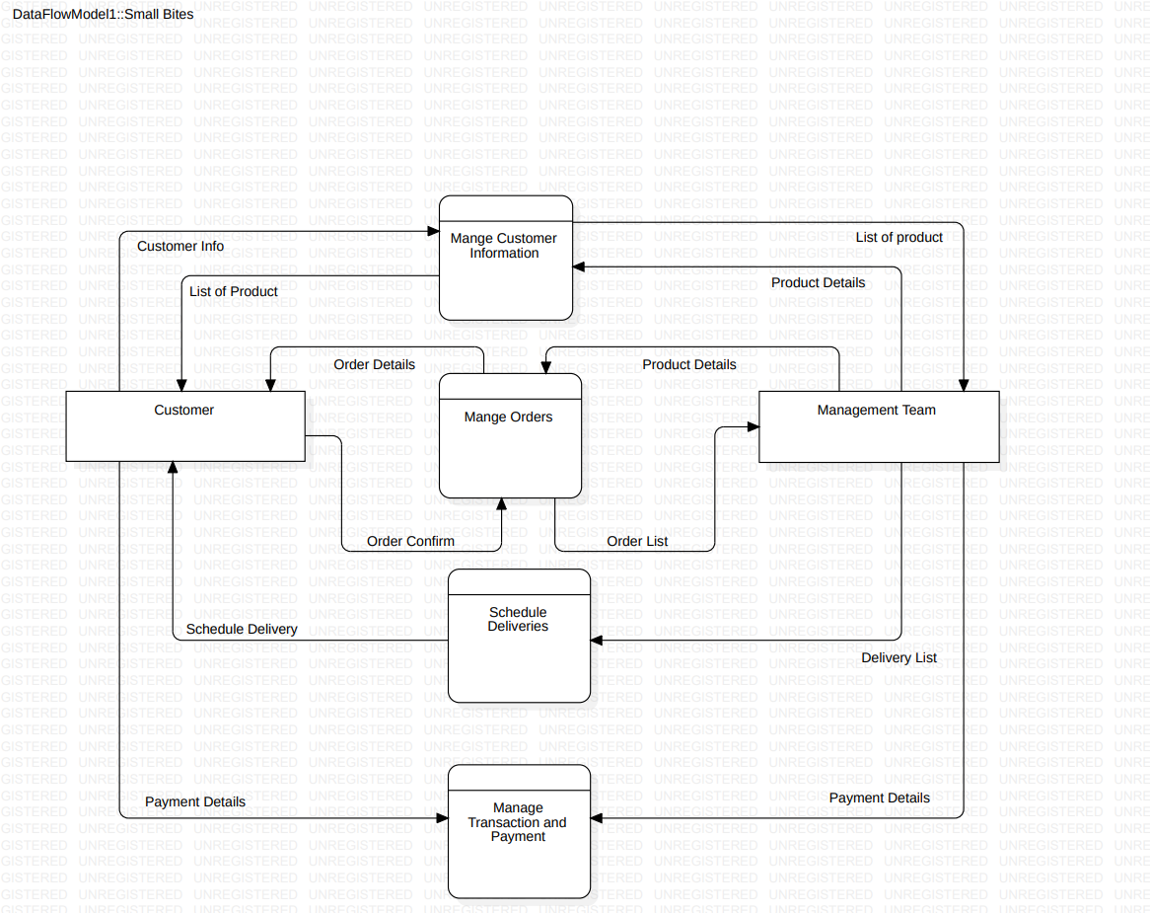
Diagrams
5.2 Level 1

Slide 20
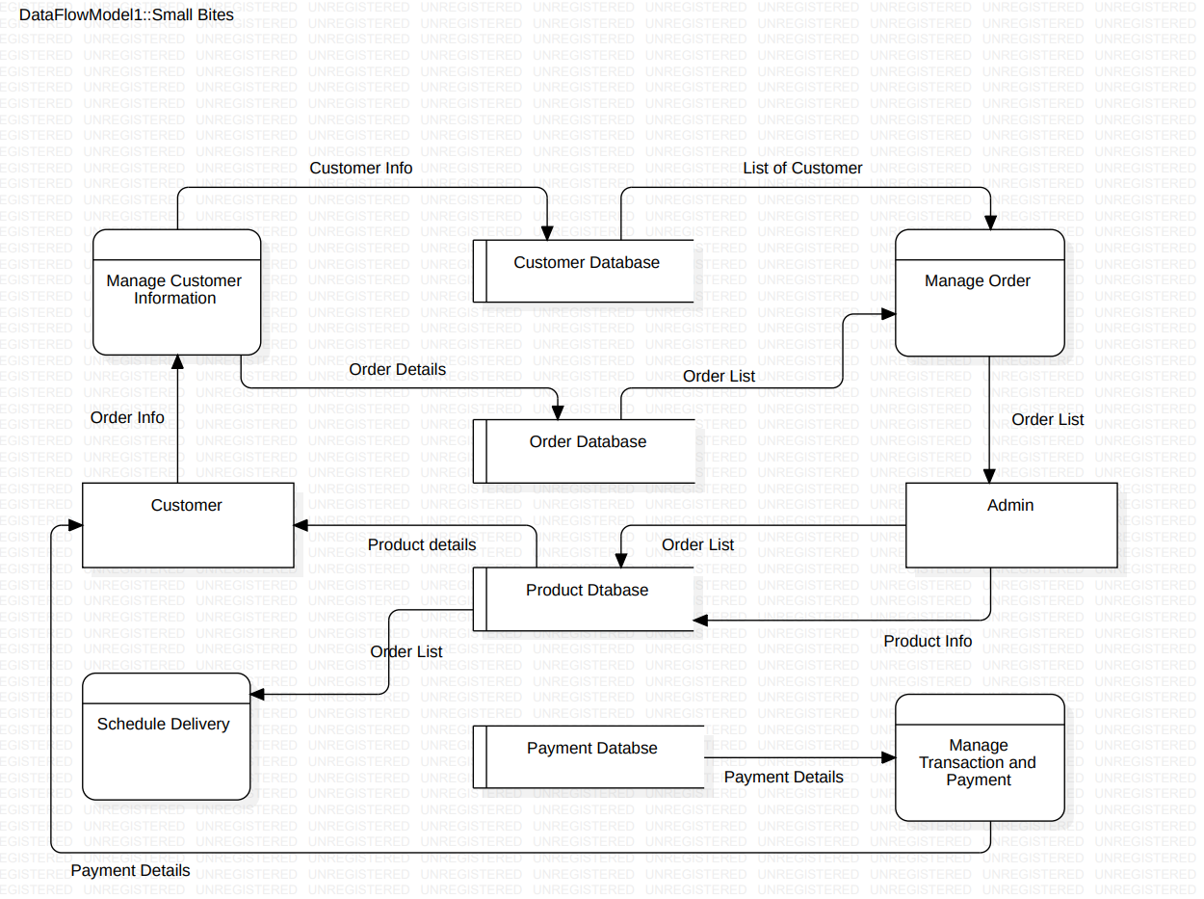
Diagrams
5.3 Level 2

Slide 21
THANK YOU

